Slide 1
ECE 4180 Project
Tim Felbinger
Ronnie Kushkuley
Richard Nguyen
Huy Hoang

Slide 2
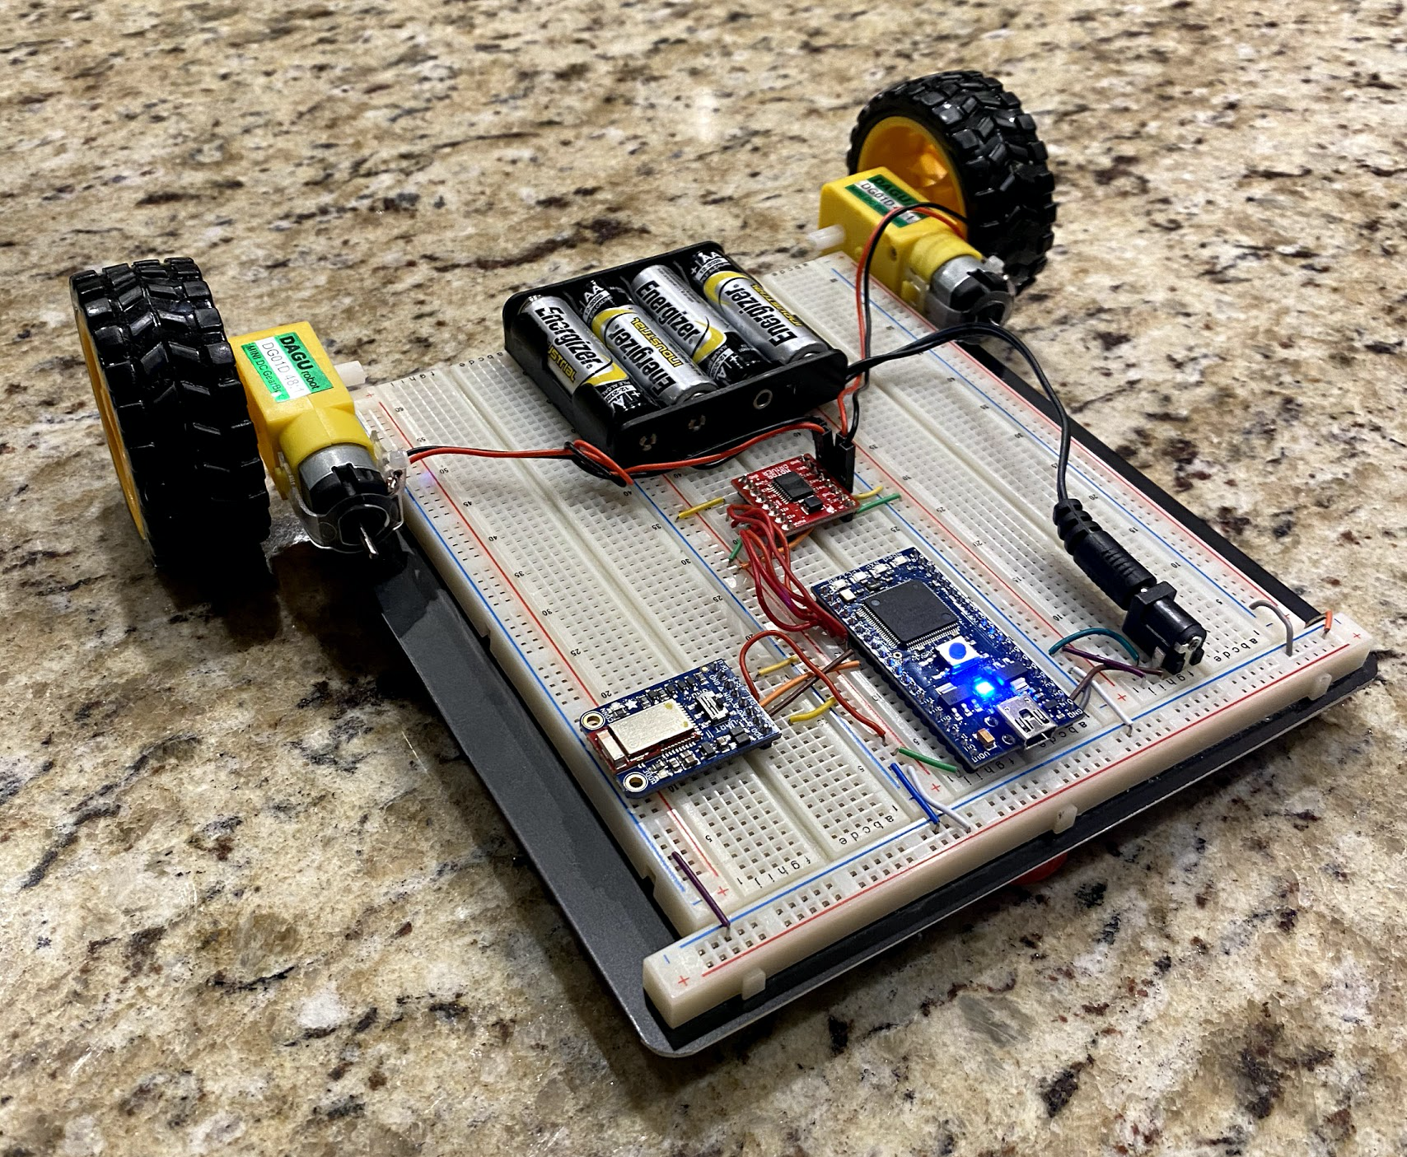
Project Description
Our team wanted to create a robotic platform that can be used for a wide array of measurement tasks using the Bluetooth, motor, and sensor technology that were learned during class.
With this robot car, users are able to use the Bluefruit Connect app to control the robot car and also receive live temperature readings from the robot car.
This platform could easily be scaled to include more sensor streams, but we were working with limited hardware availability due to COVID-19.

Slide 3
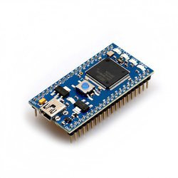
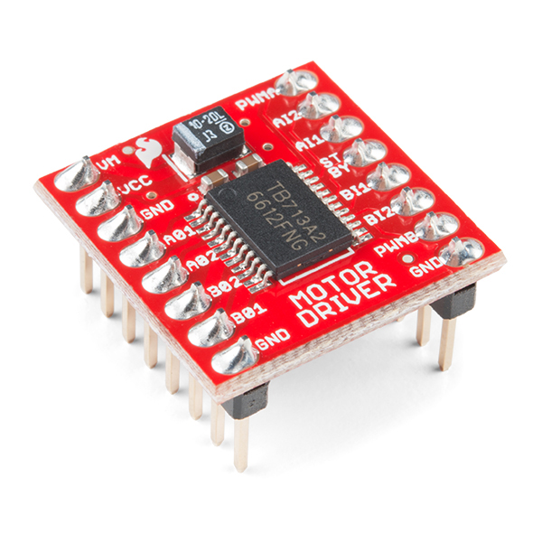
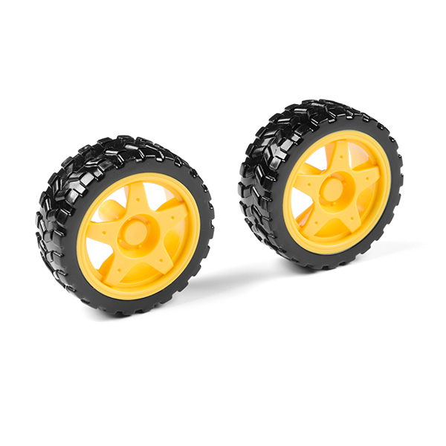
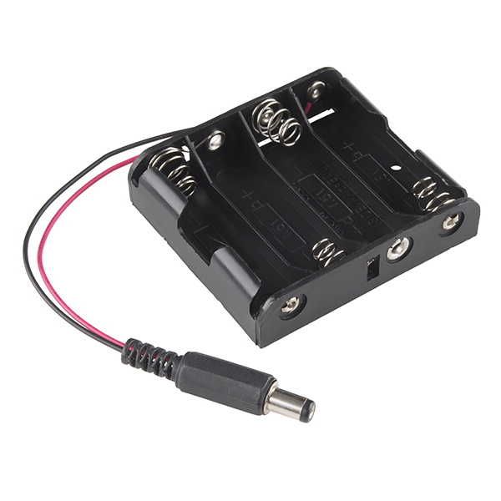
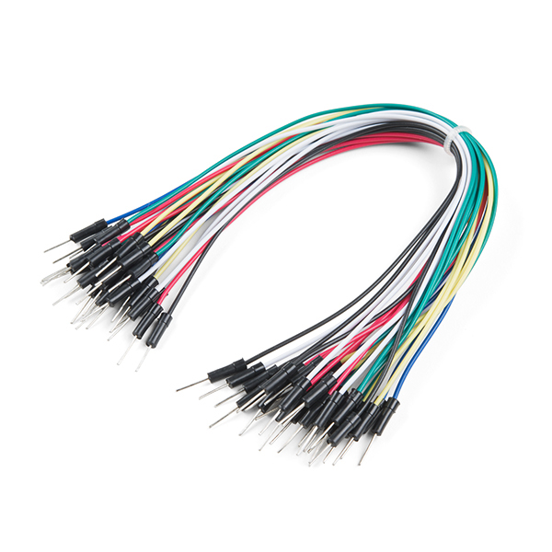
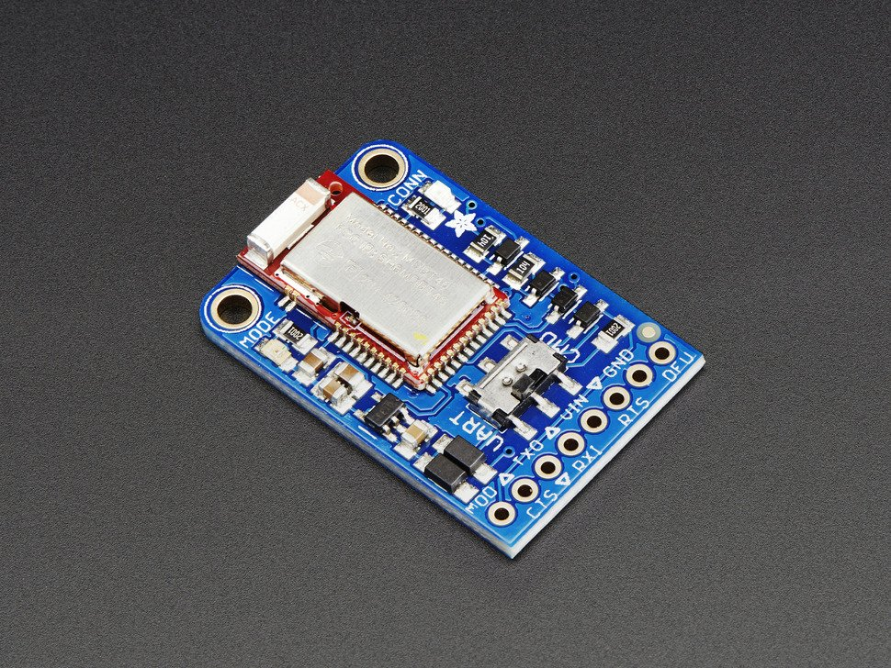
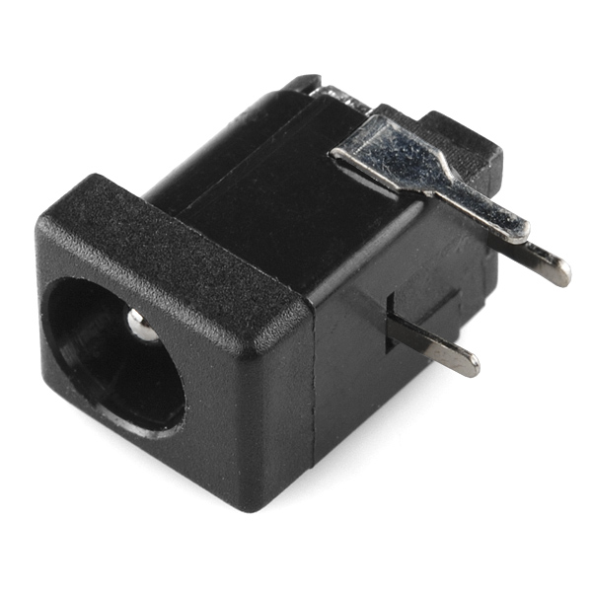
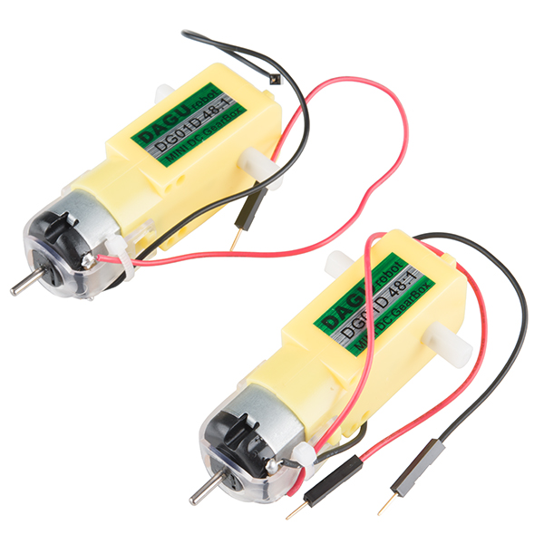
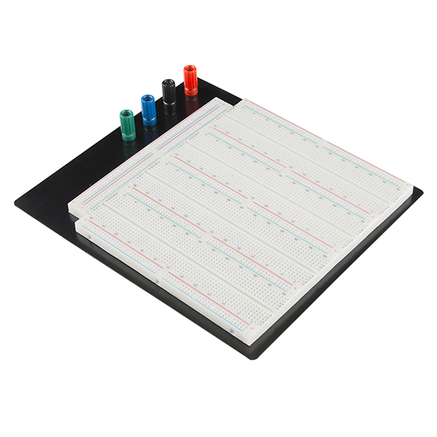
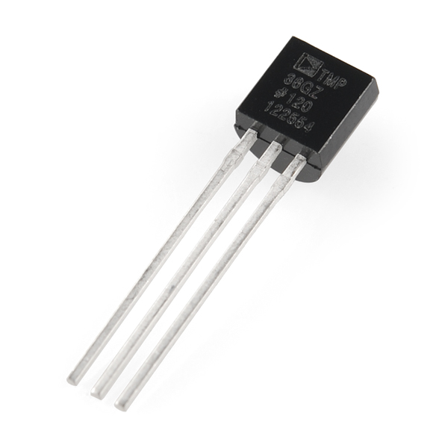
Parts List
Mbed LPC1768
Motor Driver - Dual TB6612FNG (with Headers)
Wheel - 65mm (rubber, tire, pair)
4xAA battery holder with barrel jack connector
Jumper wires
Adafruit Bluefruit LE UART Friend
DC Barrel Jack Adapter
Shadow Chasis Motor Pair
Breadboard
TMP36 Temp Sensor

Slide 4
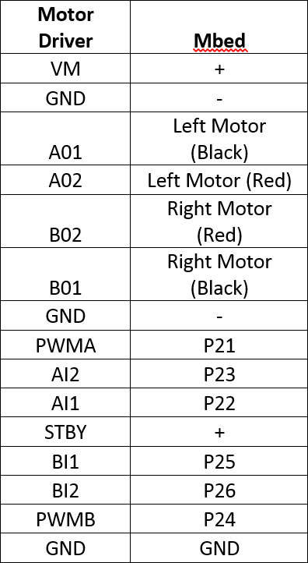
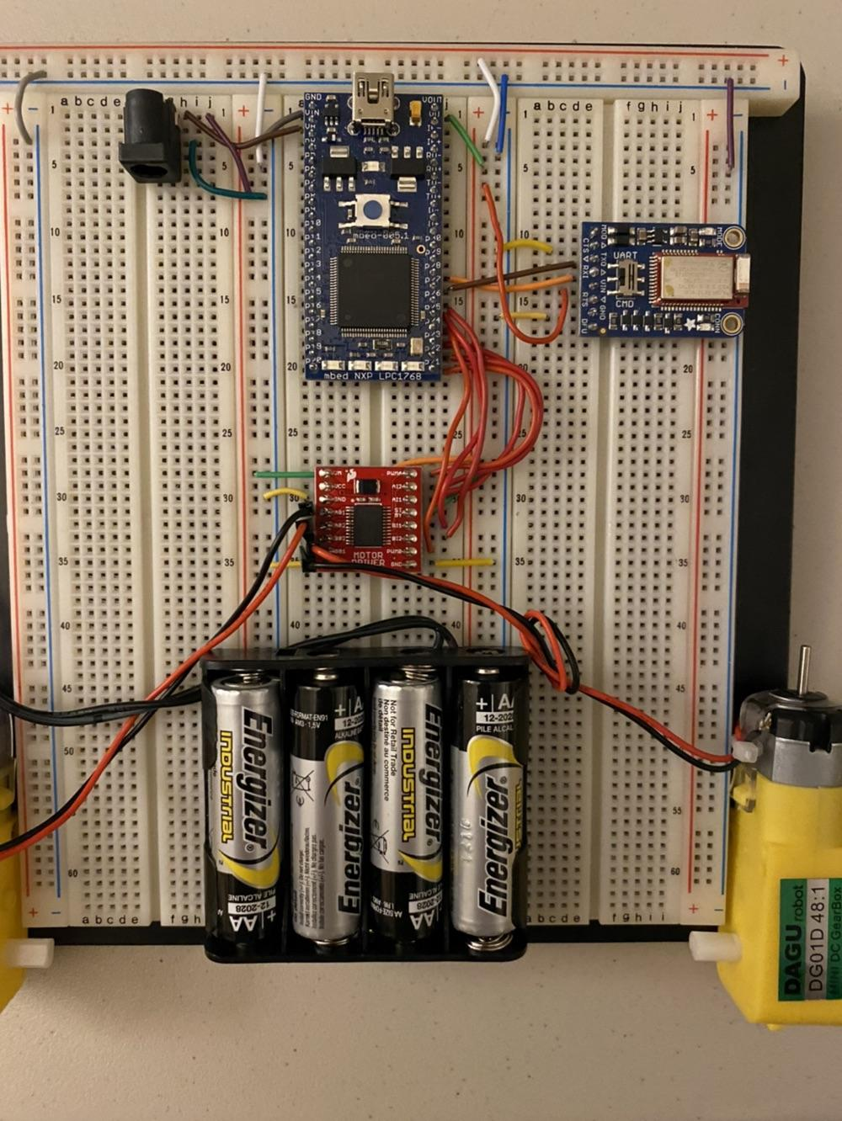
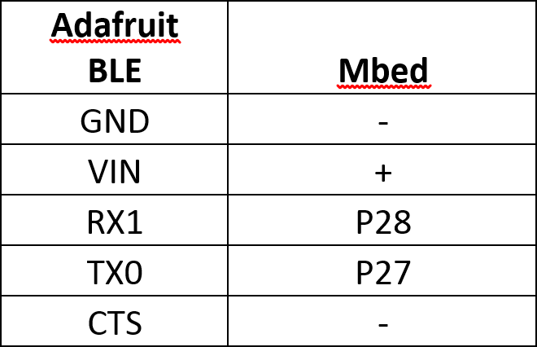
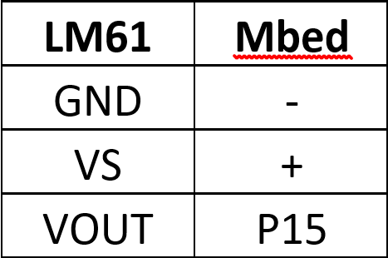
Hardware

Slide 5
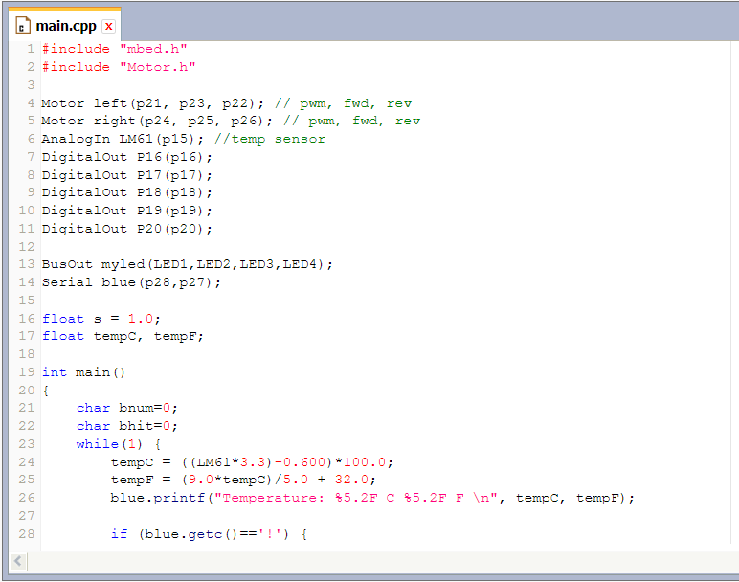
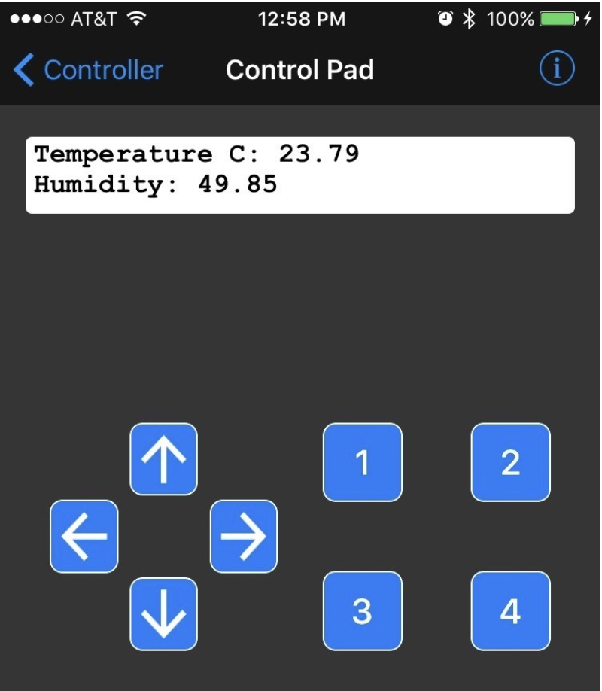
Software
For this project, we decided to integrate parts of the Bluetooth sample and motor control code that were utilized in previous labs. We also implemented lines of code to allow the Bluefruit Connect app to receive live temperature readings from the bot. With some changes to and implementing the code, we got our finished result.
Snippet of code used in this project
Control pad from Bluefruit Connect app
Notes:
**should we include a small explanation on the software part? I was thinking we could say. The software requires downloading the Bluefruit connect app which is free in app stores for android and ios phones. When running the app on the phone requires internet like Wifi or data.** - Huy

Slide 6
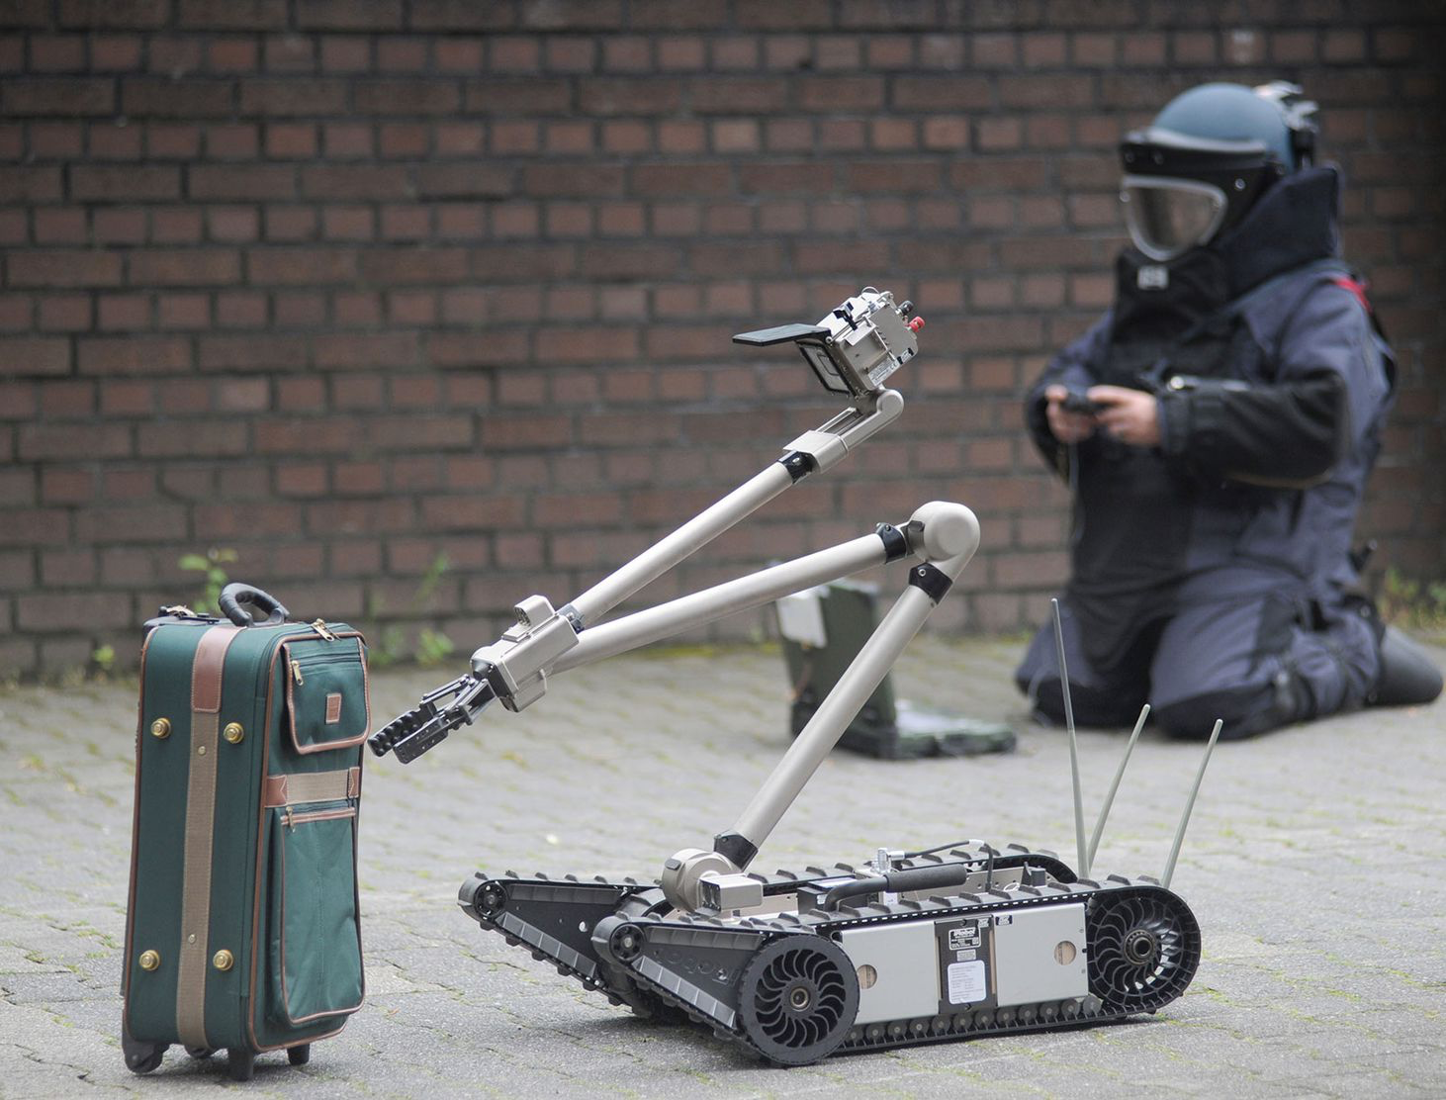
Future Additions & Revisions
Within the Control Pad of the Bluefruit app, we can customize the 4 buttons to make the robot car do certain actions that the user deems reasonable.
Add several more sensors to the robot for it to collect data beyond just temperature as shown in this project
Motor and drive system could be scaled to work with larger applications

Slide 7
Demo
https://www.youtube.com/watch?v=yoLinDj2jbA&feature=emb_title

Slide 8
Conclusion

